Slide 1



Assessing the utility of fisheries-dependent data to support mixed fisheries management: a spatiotemporal simulation framework
Paul J. Dolder, Cóilín Minto, Jean-Marc Guarini and Jan Jaap Poos
paul.dolder@gmit.ie

Slide 2
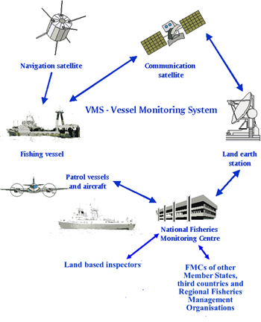

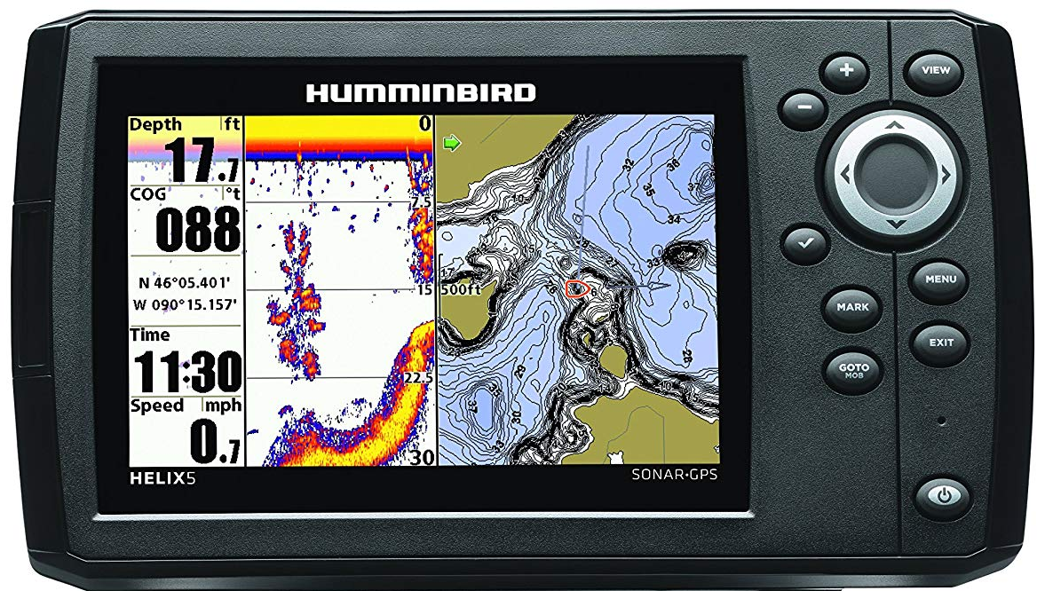
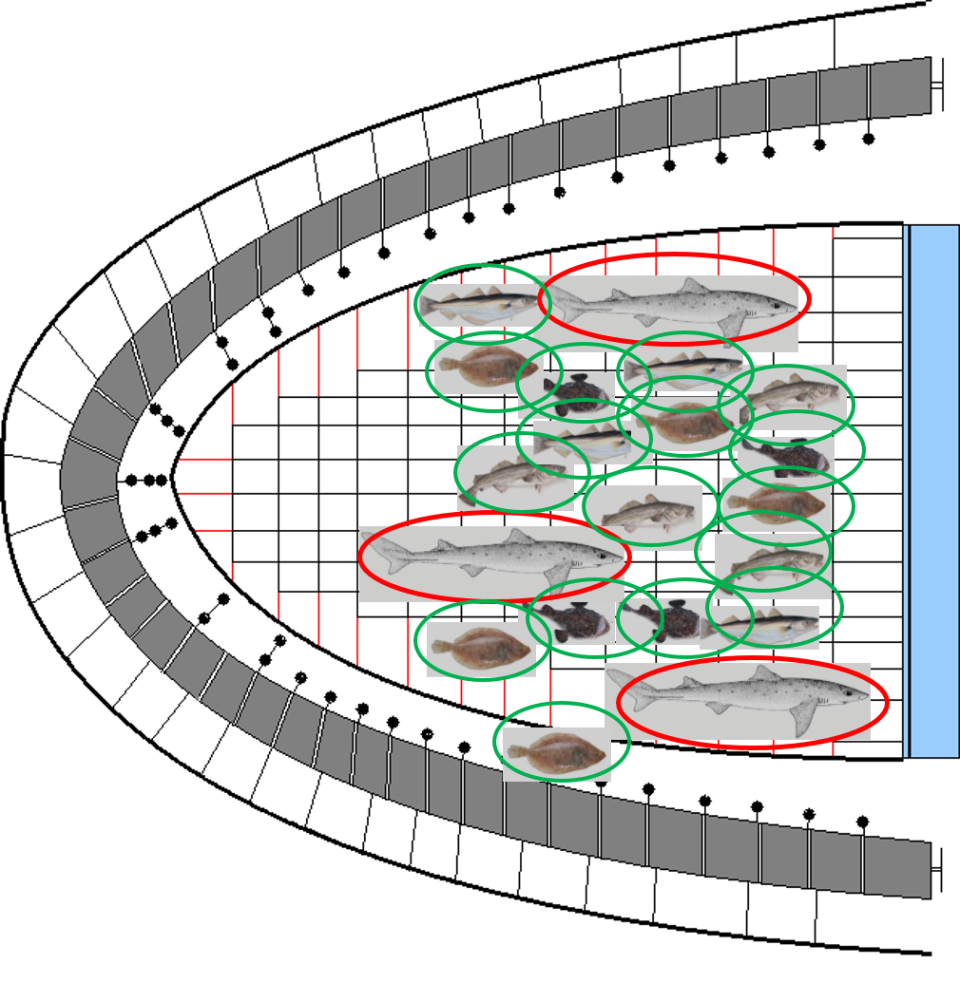

Fishing is an inherently spatiotemporal process
Fisheries catch multiple heterogeneously distributed fish stocks
Uncertainty about distribution in space-time
Provides lots of data
…but a biased sampling process: spatial (and gear-based) targeting

Slide 3
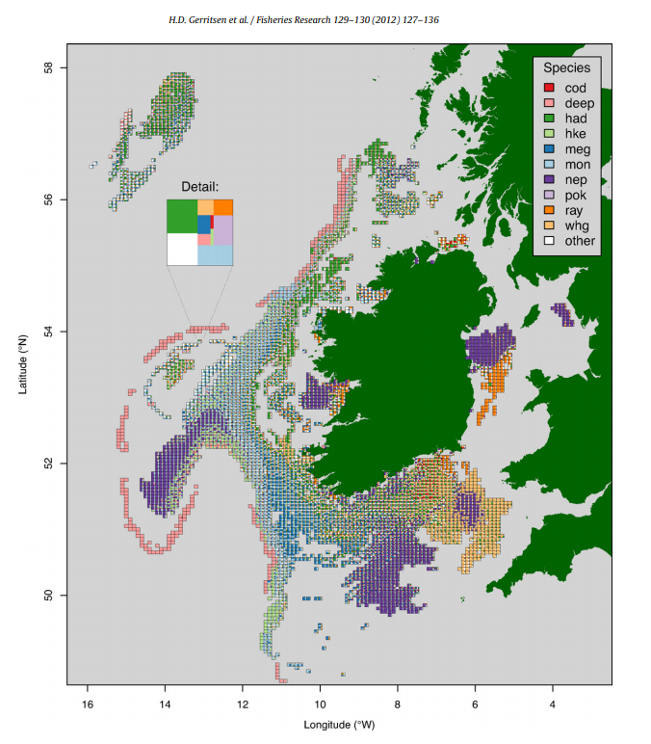
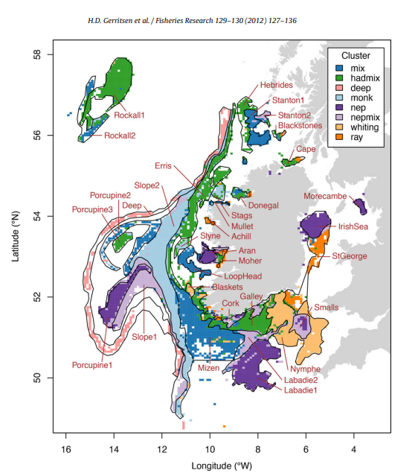
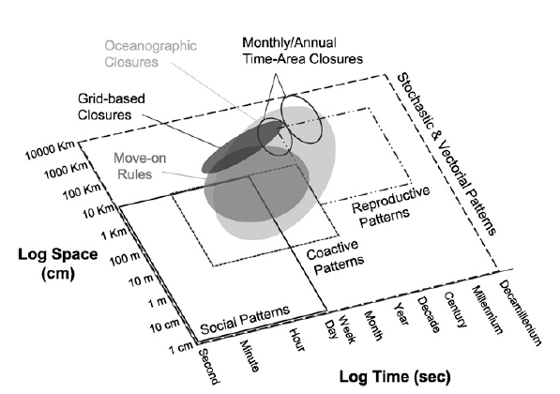
Increasing use of fisheries-dependent data to understand mixed fishery dynamics
Dunn et al 2016. PNAS 113(3) 668-673
Increasing interest in spatiotemporal management in mixed fisheries
Spatial and temporal resolution of fisheries-independent survey data sparse
Use of fisheries-dependent data, but fishing biased sampling process
True distribution of populations unknown

Slide 4
What Qs do we want to answer?
Q1. Do catches observed from the fishery reflect the underlying population structure?
Q2. At what spatial and temporal scales of aggregation are appropriate for management (does the “true” population signal degrade)?
Q3. How “useful” is commercial data for implementing spatial fisheries management measures within a mixed fishery?

Slide 5
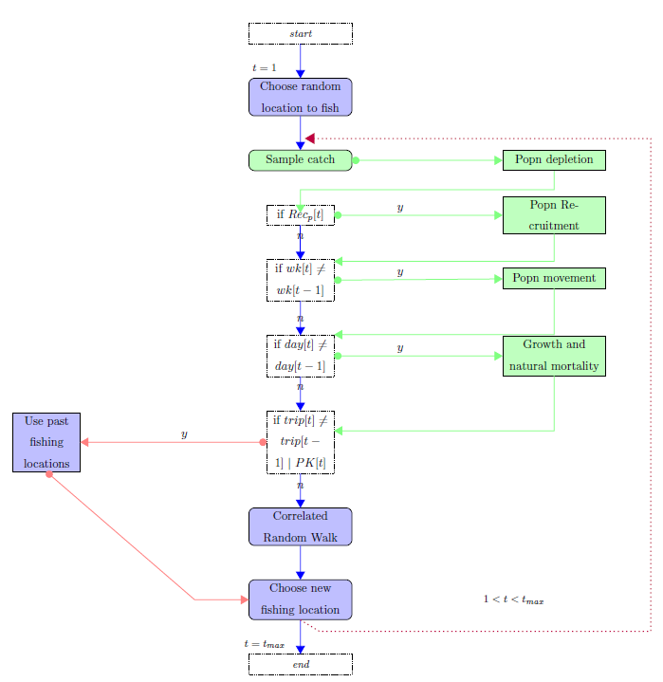
Introducing MixFishSim
Modular, event-based:
Spatial population dynamics
Vessel-level (agent-based) fishing dynamics
Highly resolved
Temporally
spatially
True population structure known at each time-step

Slide 6
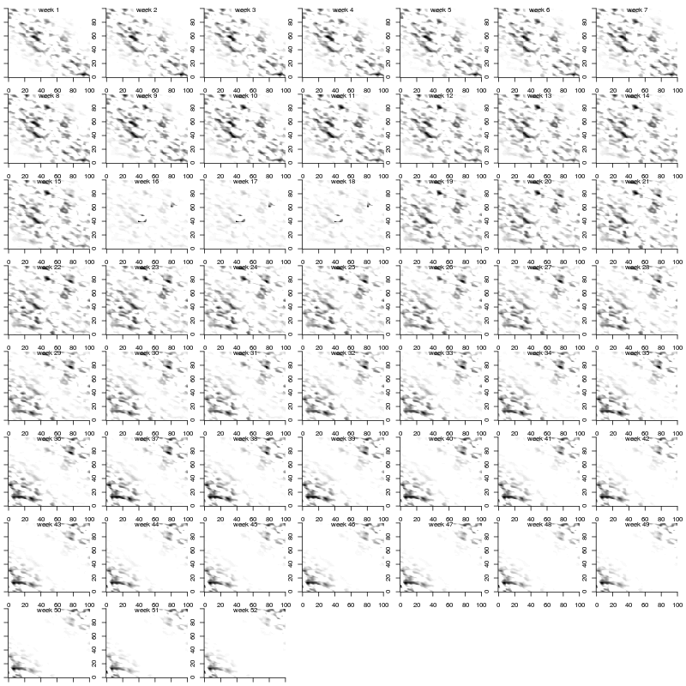
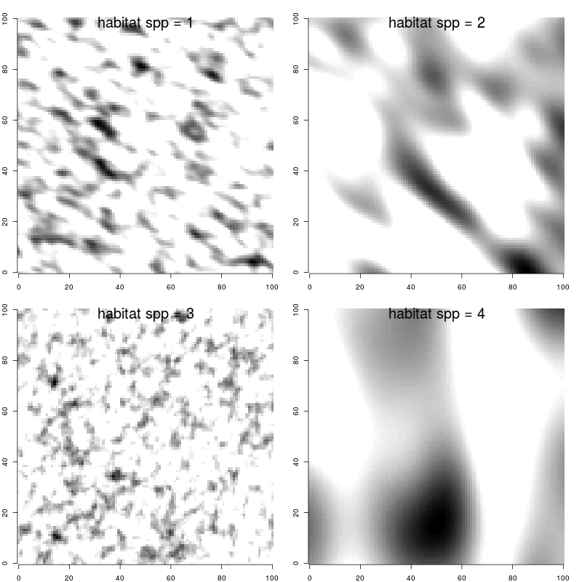
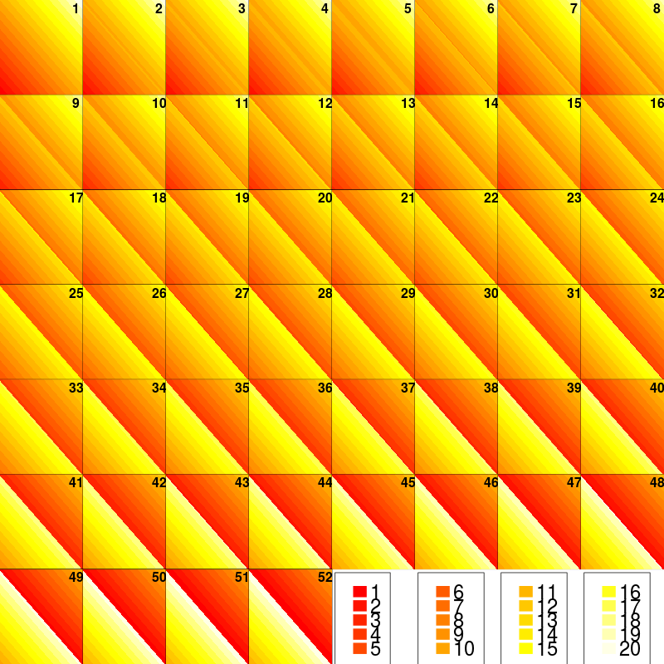
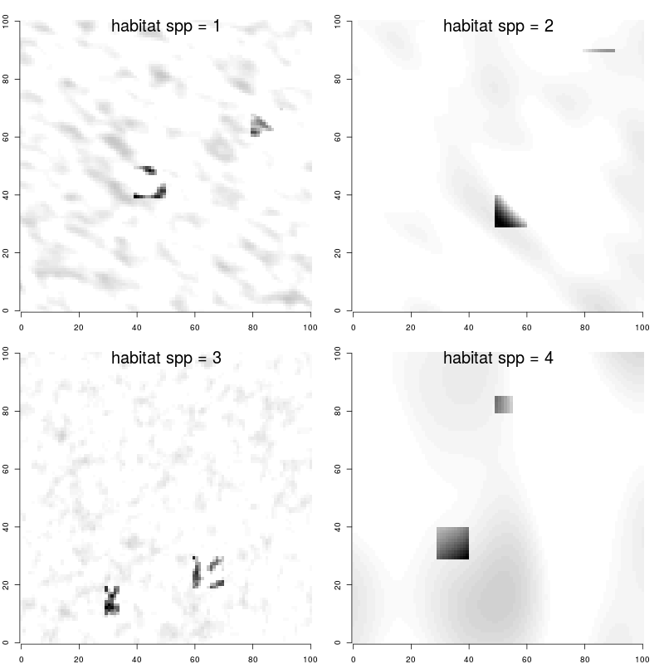
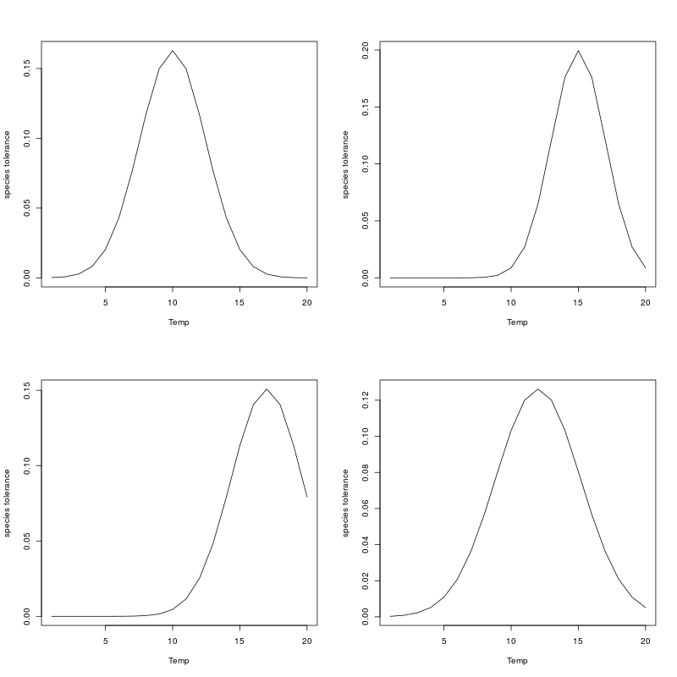
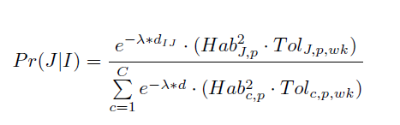
Gaussian Random Fields define habitat suitability
Define a GRF process per population for habitat suitability
Define spawning grounds per population >> increased affinity to spawning grounds during certain weeks
Define a temperature field per week, and individual population tolerances
Populations move between cells according to maximum distance, habitat suitability and temp tolerance

Slide 7
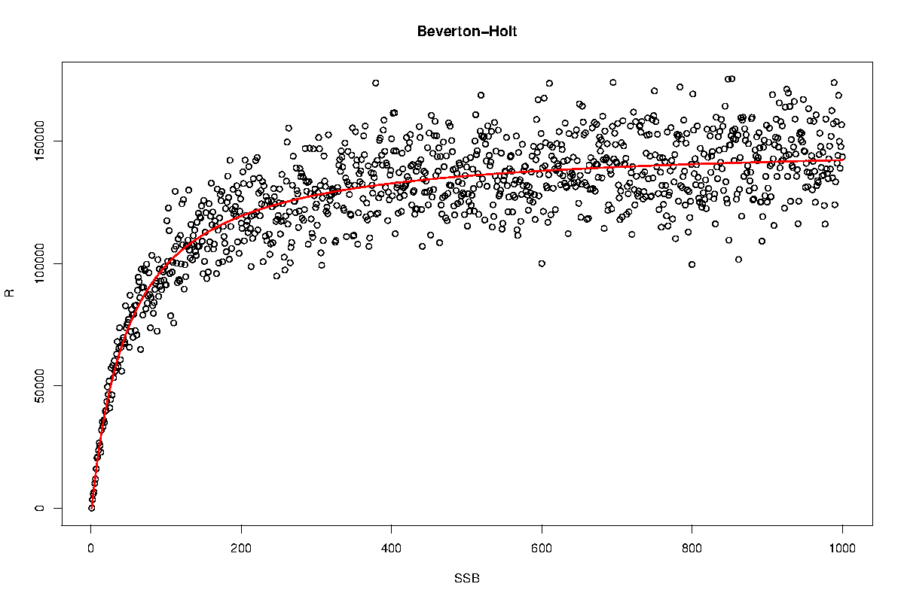
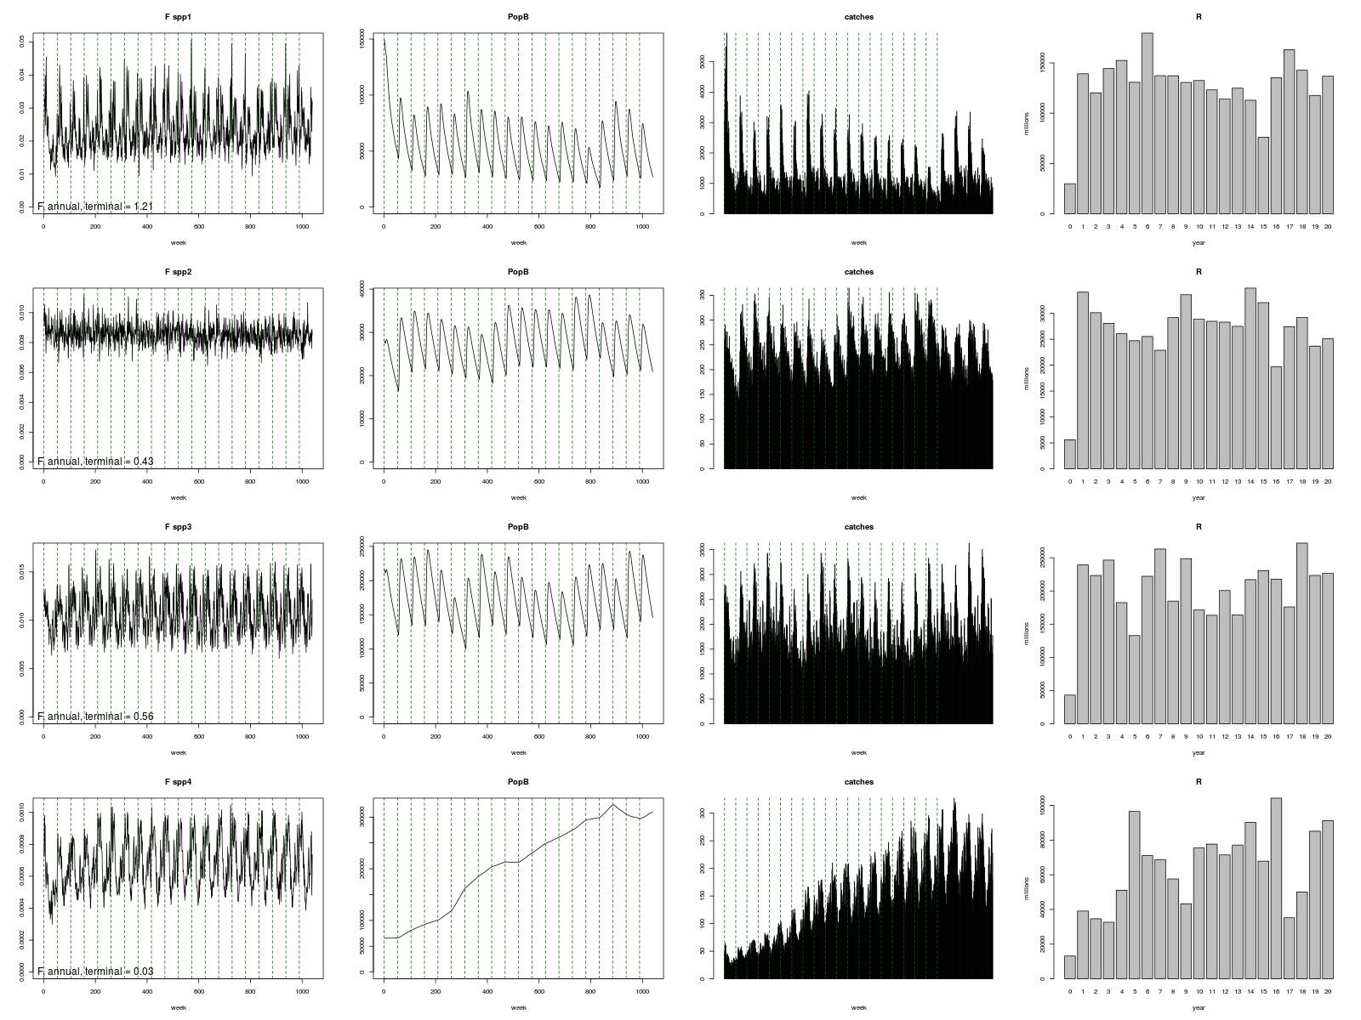
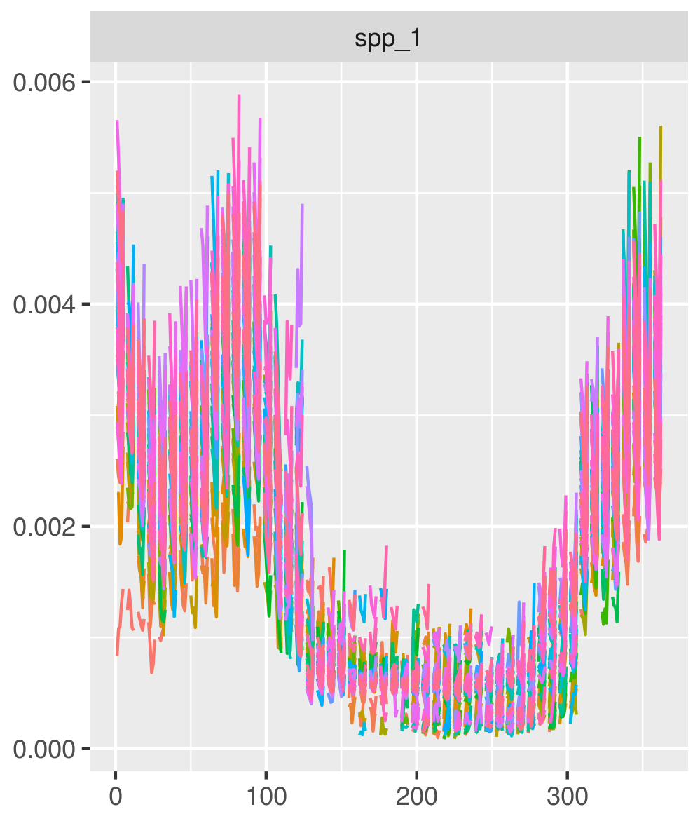
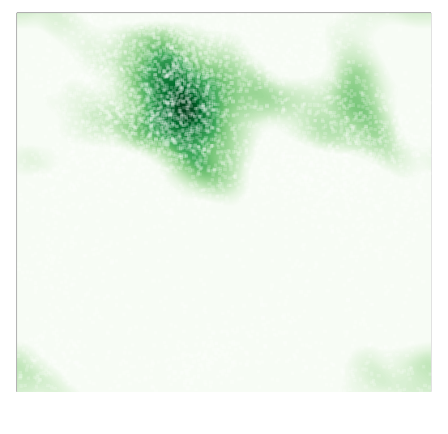
Spatially resolved population dynamics
Catch and spatial depletion of population per day
2-stage biomass delay difference model
Recruitment function

Slide 8
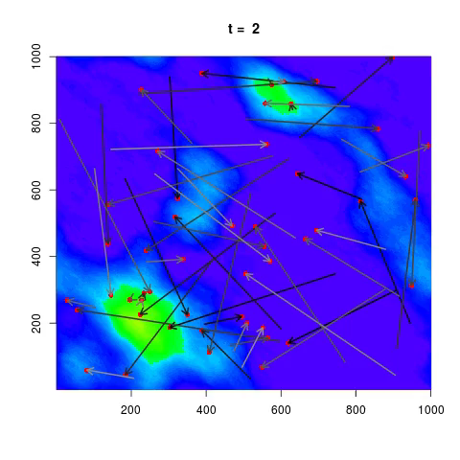
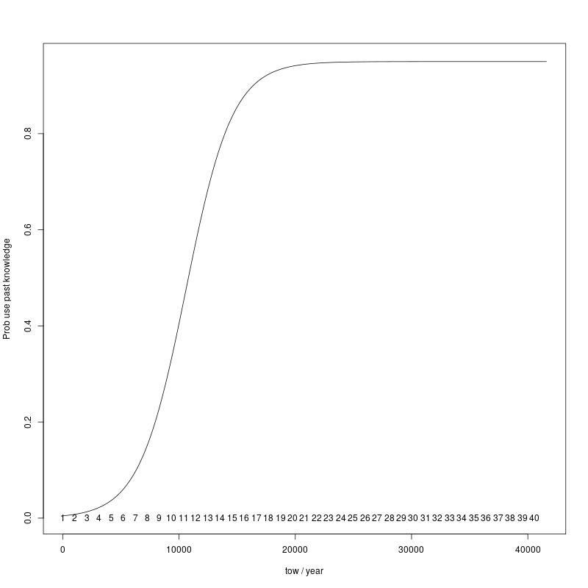
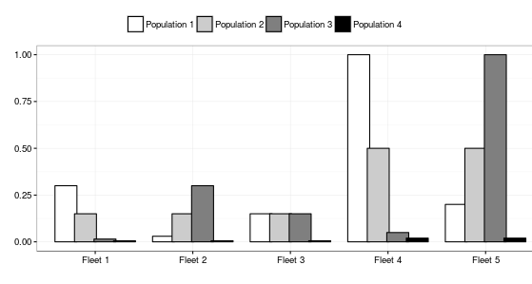
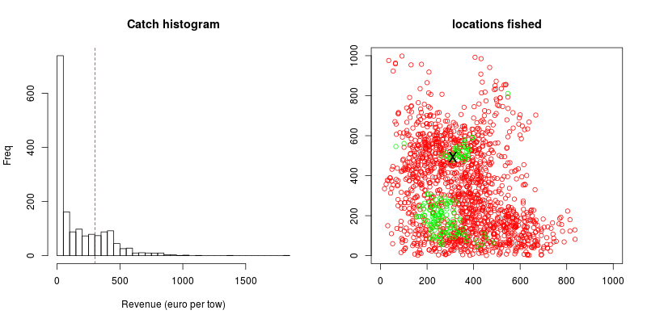
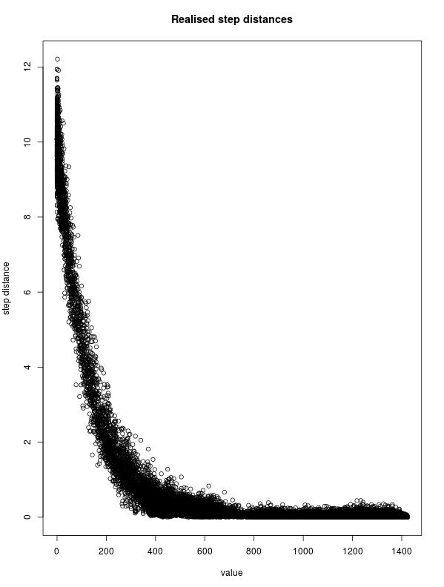
Individual vessel-based fishery dynamics
Transition from exploratory to established fishery
Exploratory:
Correlated Random Walk
Transition:
Mix
Established:
(mostly) past experience of individual
Established phase
Transition phase
Exploratory phase

Slide 9
Simulation experiment: spatial closures
4 populations
5 fleets of 20 vessels each
40 year simulation
20 years to establish
10 year “data”
10 year closure to protect a population
3 data sources:
“real” population
Inferred from fishery
Inferred from “survey”
3 temporal resolutions:
Weekly
Monthly
Yearly
4 spatial resolutions
1 x 1
5 x 5
10 x 10
20 x 20

Slide 10
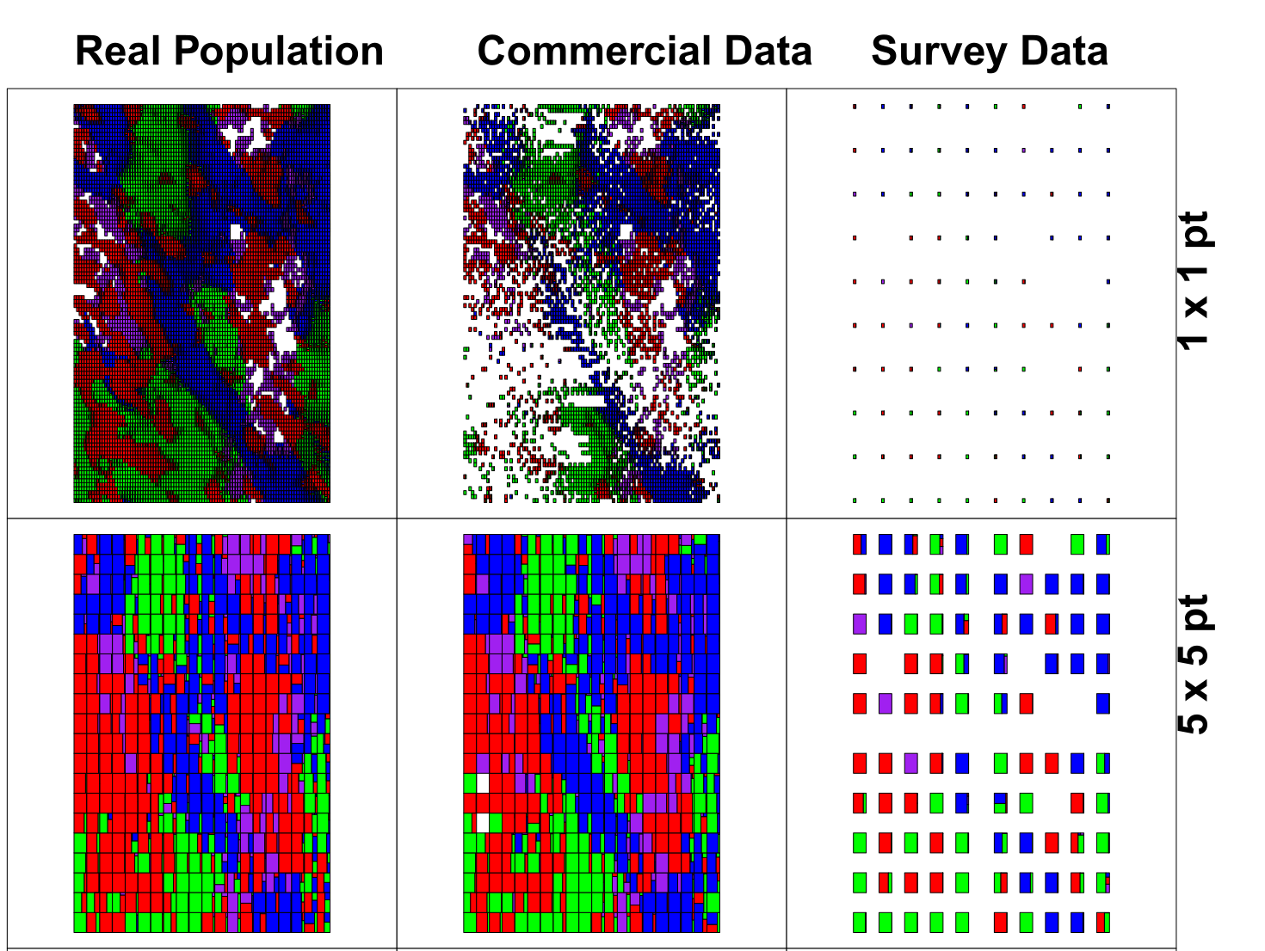
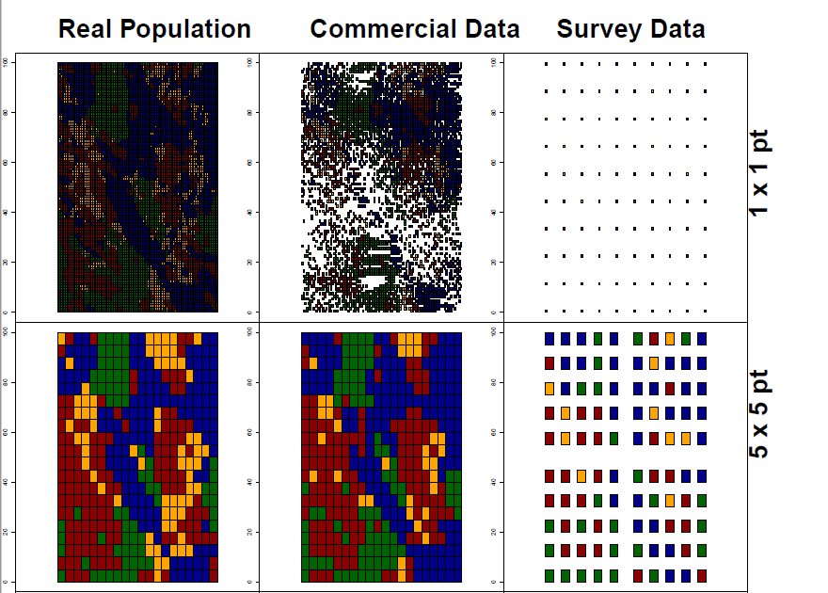
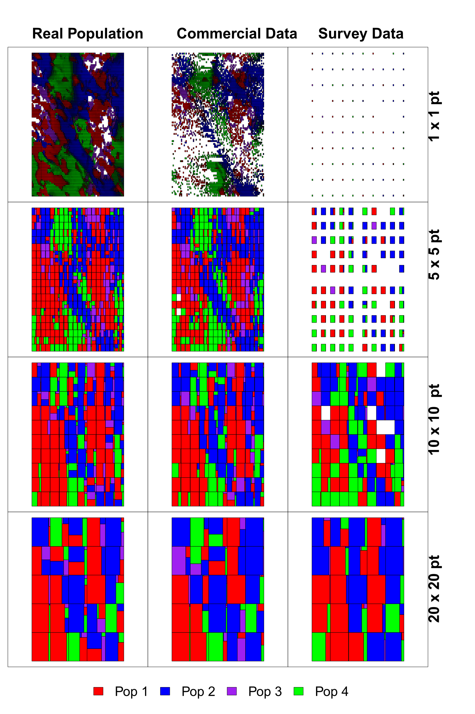
The Spatial dimension
Commercial data (despite its biases) shows reasonable relation to the underlying population structure
Survey data spatial sparse which can lead to some inconsistencies when more aggregated
Commercial and survey have data gaps: inference from modelling necessary

Slide 11
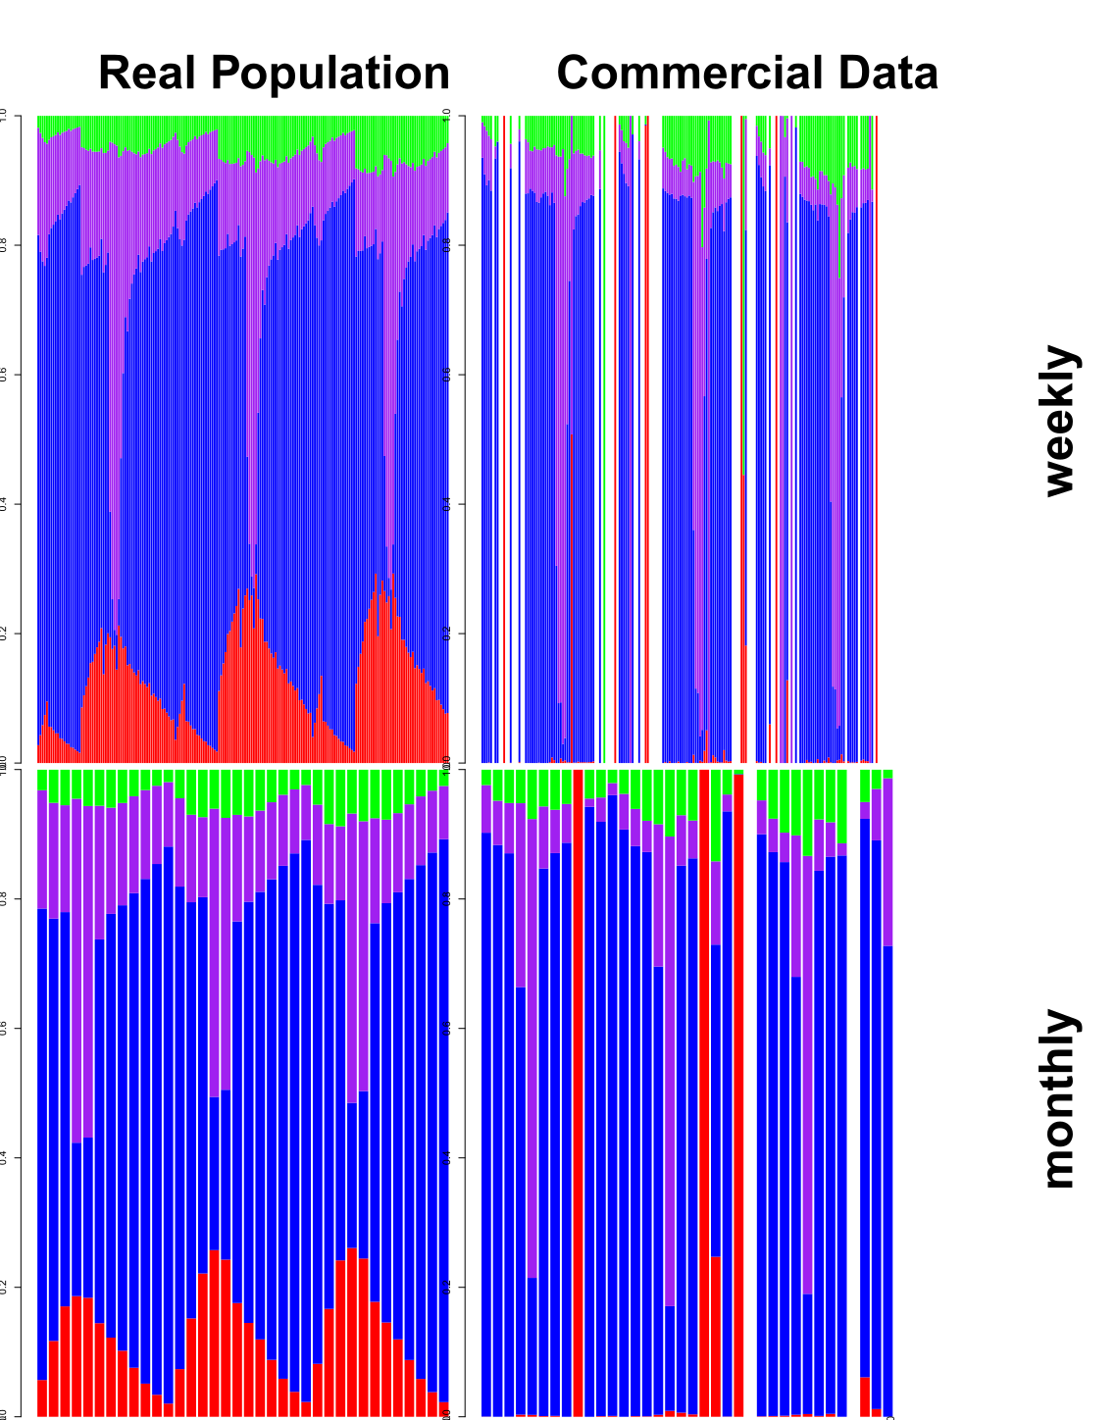
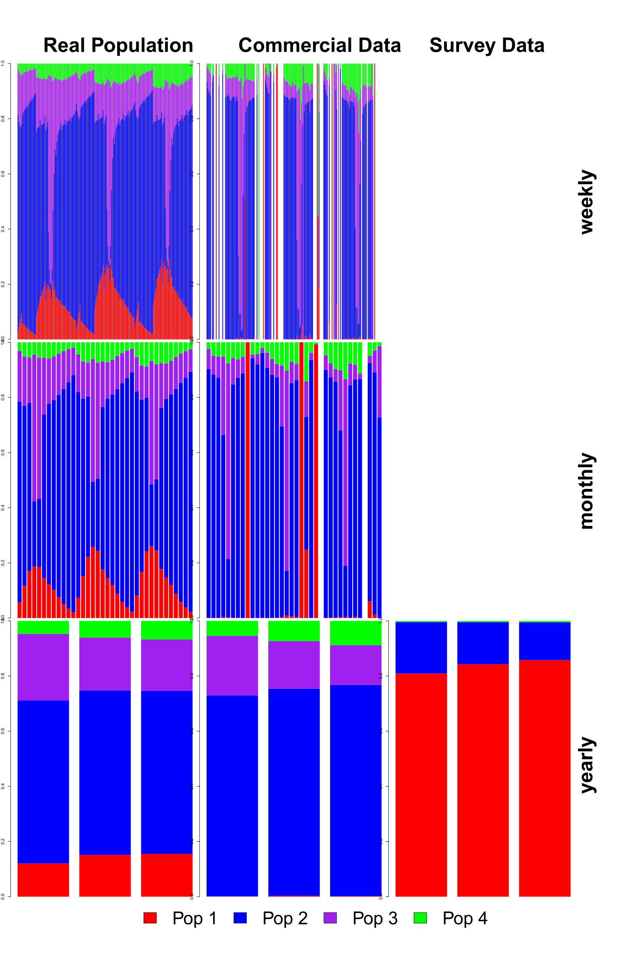
The temporal dimension
Commercial data has some gaps for the weekly data, also population 1 is under-sampled for all temporal scales.
Survey data oversamples population 1 for the annual data and under-samples population 3 & 4
*Weekly / monthly data not available for survey

Slide 12
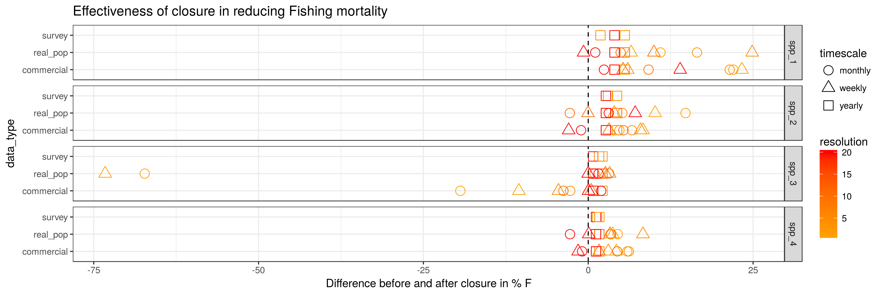
Simulated closure “experiment”
Scenarios based on “real population” most effective, though not for annual closures (no single location effective).
Scenarios based on survey ineffective (as above).
Scenario based on commercial data were effective in some cases, best was 1 x 1 grid aggregated to a monthly level (sufficiently captures temporal dynamics, more spatial data due to increased samples).

Slide 13
Summary: what can we say about our Qs?
Q1. Do catches observed from the fishery reflect the underlying population structure?
Q2. At what spatial and temporal scales of aggregation are appropriate for management (does the “true” population signal degrade)?
Q3. How “useful” is commercial data for implementing spatial fisheries management measures within a mixed fishery?
Reasonable representation of the simulated populations at finer spatial and temporal resolutions, but then lack sufficient data
Monthly finescale seems reasonable for our experimental system: good compromise between data availability and population movement rates (elsewhere, population move-on rules have been 2-3 weeks)
Commercial data potentially useful and more representative than once-a-year survey, though effectiveness of closure potentially moderated by biases in data (lack of full picture)

Slide 14
Questions remaining
How can population movement and dynamics be improved?
Can we use the model for testing models based on more aggregated data (e.g. RUMs, Markov)
Can we use this information to help design more effective spatiotemporal management from comercial data?
R package ‘MixFishSim’ to be realeased

Slide 15



Thank you for listening!
Questions?
Acknowledgements:

Slide 16
Extra material

Slide 17
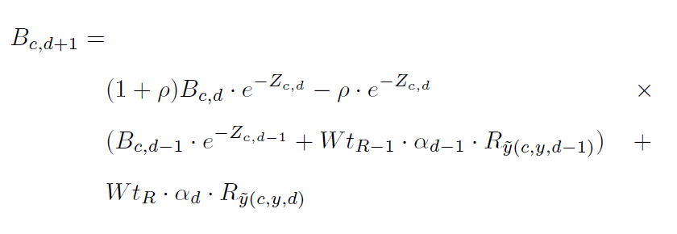
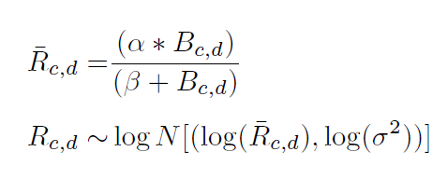
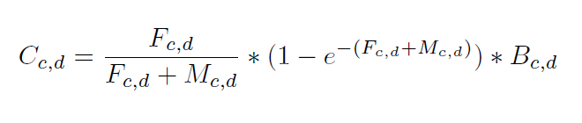
Spatially resolved population dynamics
2-stage biomass delay difference model
Recruitment function
Catch and spatial depletion of population per day

